Slide 1
Graphing in Science

Slide 2
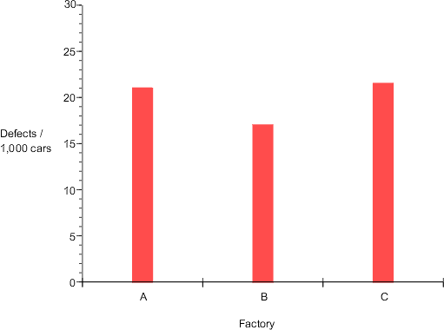
Bar Graph- used to compare data/quantities

Slide 3
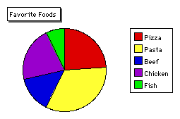
Circle/Pie Graph- used to show percentages

Slide 4
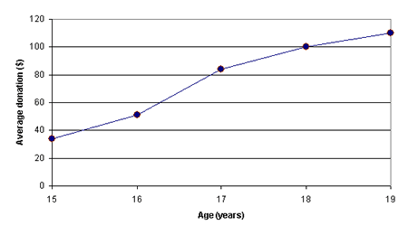
Line Graph- used to show a trend over a period of time or a relationship between two variables.

Slide 5
Remember to:
ALWAYS label both axis, include UNITS.
Scale your axis numbers to use most of the graph, using the most appropriate increments.
Draw a best fit line.
Title your graph
Make a key for data if needed. (more than one line on a graph)

